Slide 1
Recommender Systems
It is an algorithm that suggests relevant items to users. Eg: In the case of Netflix which movie to watch, In the case of e-commerce which product to buy, or In the case of kindle which book to read, etc.
Use-Cases Of Recommendation System
There are many use-cases of it. Some are
A. Personalized Content: Helps to Improve the on-site experience by creating dynamic recommendations for different kinds of audiences like Netflix does.
B. Better Product search experience: Helps to categories the product based on their features. Eg: Material, Season, etc.
TYPES OF RECOMMENDATION SYSTEM
Content-Based Filtering
Collaborative Based Filtering

Slide 2
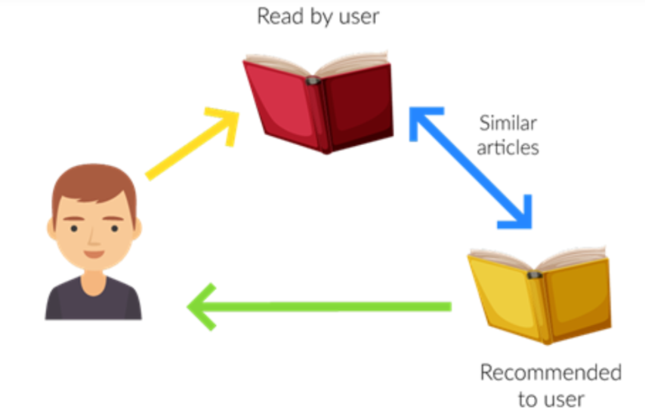
Content-Based Filtering
Relevant items are shown using the content of the previously searched items by the users. Here content refers to the attribute/tag of the product that the user like. In this type of system, products are tagged using certain keywords, then the system tries to understand what the user wants and it looks in its database and finally tries to recommend different products that the user wants.
Let us take an example of the movie recommendation system where every movie is associated with its genres which in the above case is referred to as tag/attributes. Now let assume user A gives a good rating to movies based on the action genre and a bad rating to the movies based on the anime genre. So here system recommends action movies to the users.
Advantage
Model doesn’t need data of other users since recommendations are specific to a single user.
It makes it easier to scale to a large number of users.
The model can Capture the specific Interests of the user and can recommend items that very few other users are interested in.
Disadvantage
Feature representation of items is hand-engineered to some extent, this tech requires a lot of domain knowledge.
The model can only make recommendations based on the existing interest of a user. In other words, the model has limited ability to expand on the user’s existing interests.

Slide 3
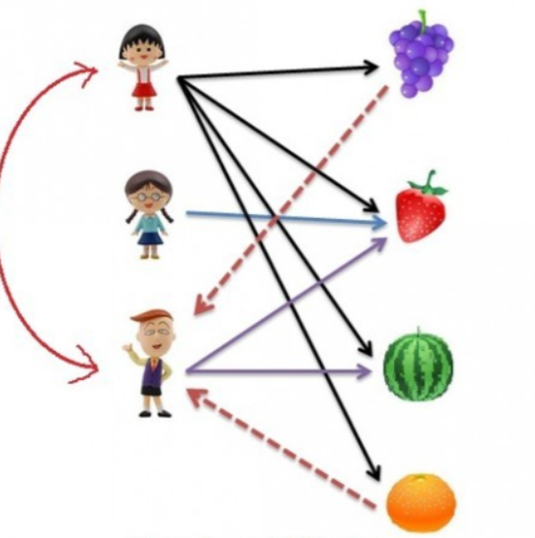
Collaborative Based Filtering
Recommending the new items to users based on the interest and preference of other similar users is basically collaborative-based filtering. This overcomes the disadvantage of content-based filtering as it will use the user Interaction instead of content from the items used by the users. For this, it only needs the historical performance of the users.
There are 2 types of collaborative filtering:-
A. User-Based Collaborative Filtering
Rating of the item is done using the rating of neighbouring users. In simple words, It is based on the notion of users’ similarity.
Let see an example. On the left side, you can see a picture where 3 children named A, B, C, and 4 fruits i.e, grapes, strawberry, watermelon, and orange respectively.
Based on the image let assume A purchased all 4 fruits, B purchased only strawberry and C purchased strawberry as well as watermelon. Here A & C are similar kinds of users because of this C will be recommended Grapes and Orange as shown in dotted line.

Slide 4
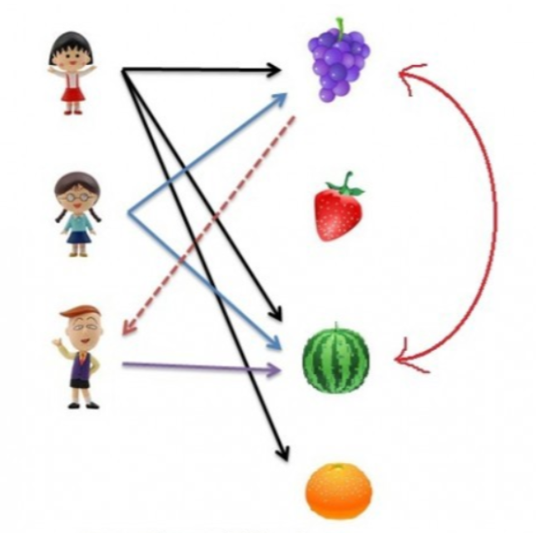
B. Item-Based Collaborative Filtering
The rating of the item is predicted using the user’s own rating on neighbouring items. In simple words, it is based on the notion of item similarity.
Let us see with an example as told above about users and items. Here the only difference is that we see similar items, not similar users like if you see grapes and watermelon you will realize that watermelon is purchased by all of them but grapes are purchased by Children A & B. Hence Children C is being recommended grapes.
Now after understanding both of them you may be wondering which to use when. Here is the solution if No. of items is greater than No. of users go with user-based collaborative filtering as it will reduce the computation power and If No. of users is greater than No. of items go with item-based collaborative filtering. For Example, Amazon has lakhs of items to sell but has billions of customers. Hence Amazon uses item-based collaborative filtering because of less no. of products as compared to its customers.
ITem based: 4C2 = 6
User based: 3C2 = 3

Slide 5
Practical application:
https://pub.towardsai.net/recommendation-system-in-depth-tutorial-with-python-for-netflix-using-collaborative-filtering-533ff8a0e444
https://realpython.com/build-recommendation-engine-collaborative-filtering/
https://towardsdatascience.com/item-based-collaborative-filtering-in-python-91f747200fab

Slide 6
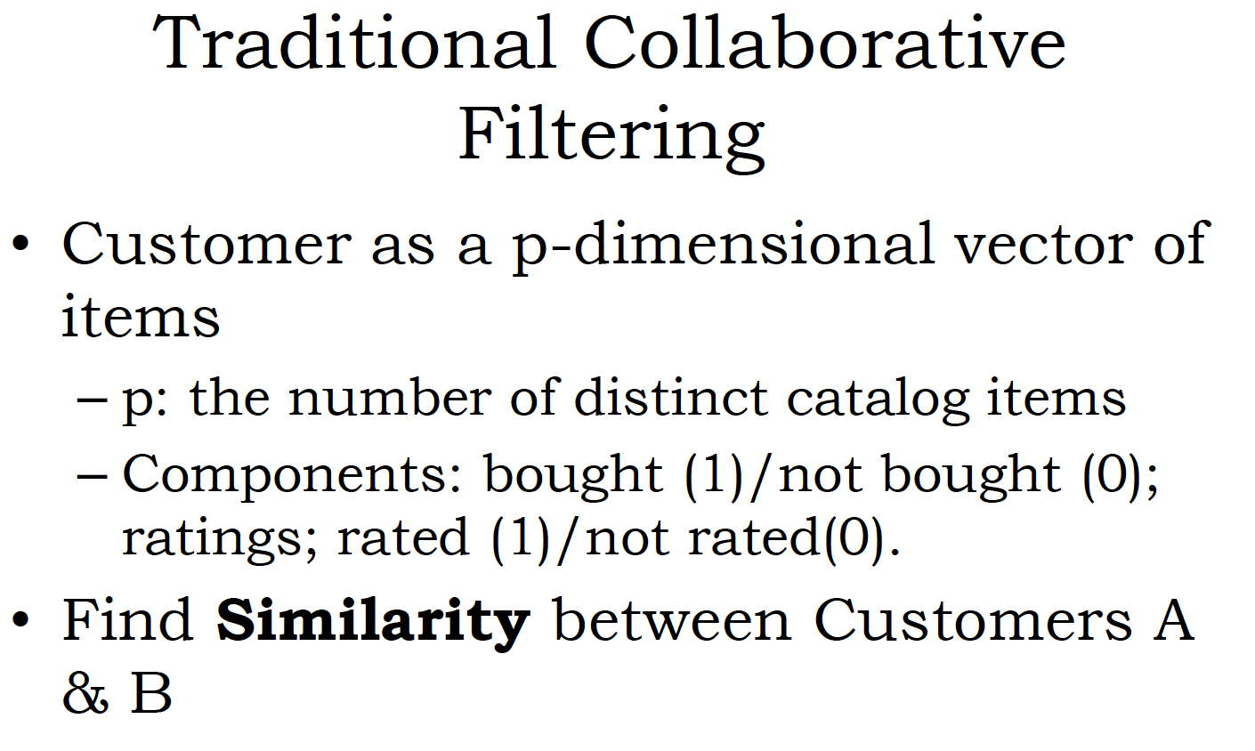

Slide 7
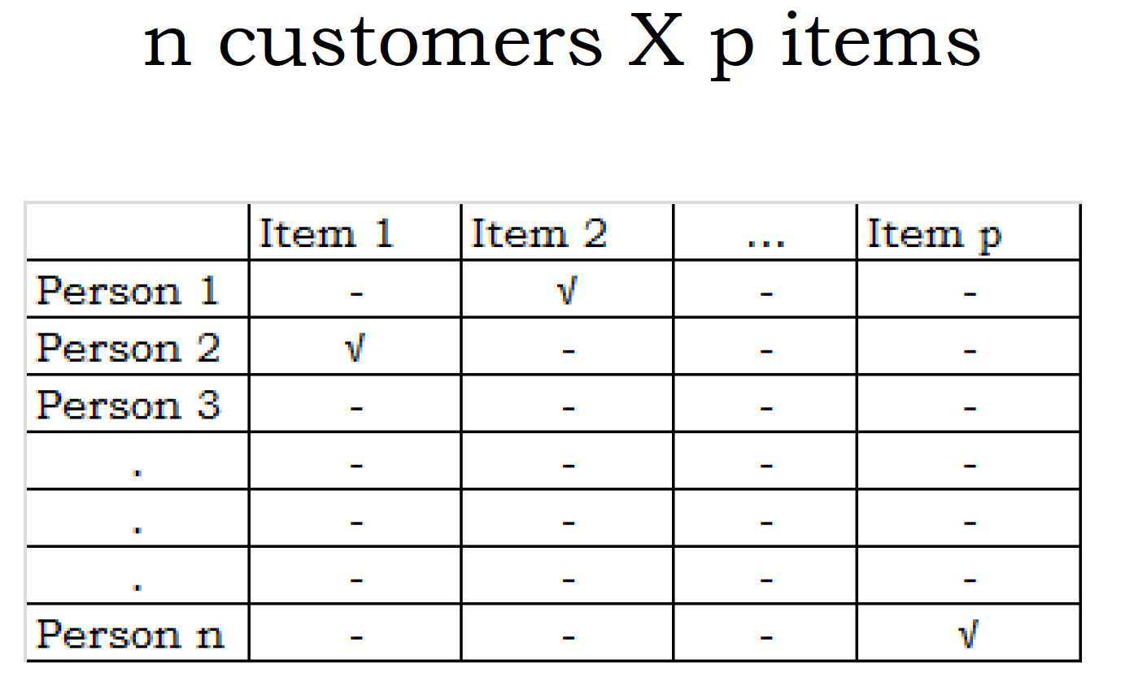
Sparse matrix: which has lot of 0’s/ NA’s

Slide 8
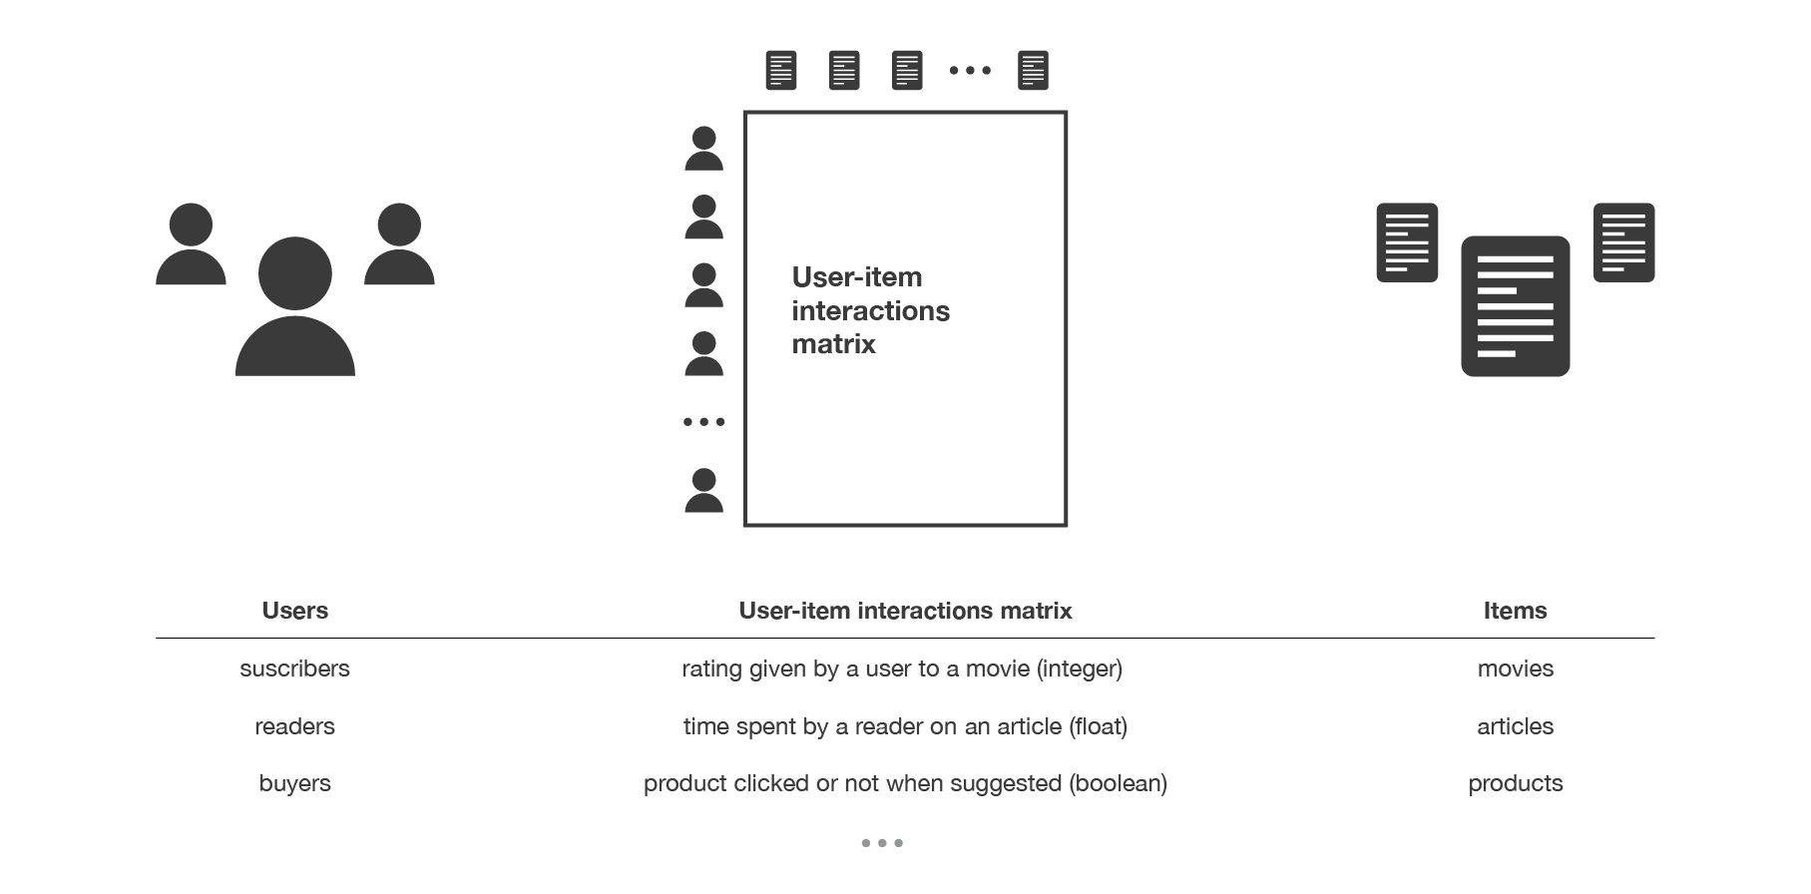

Slide 9
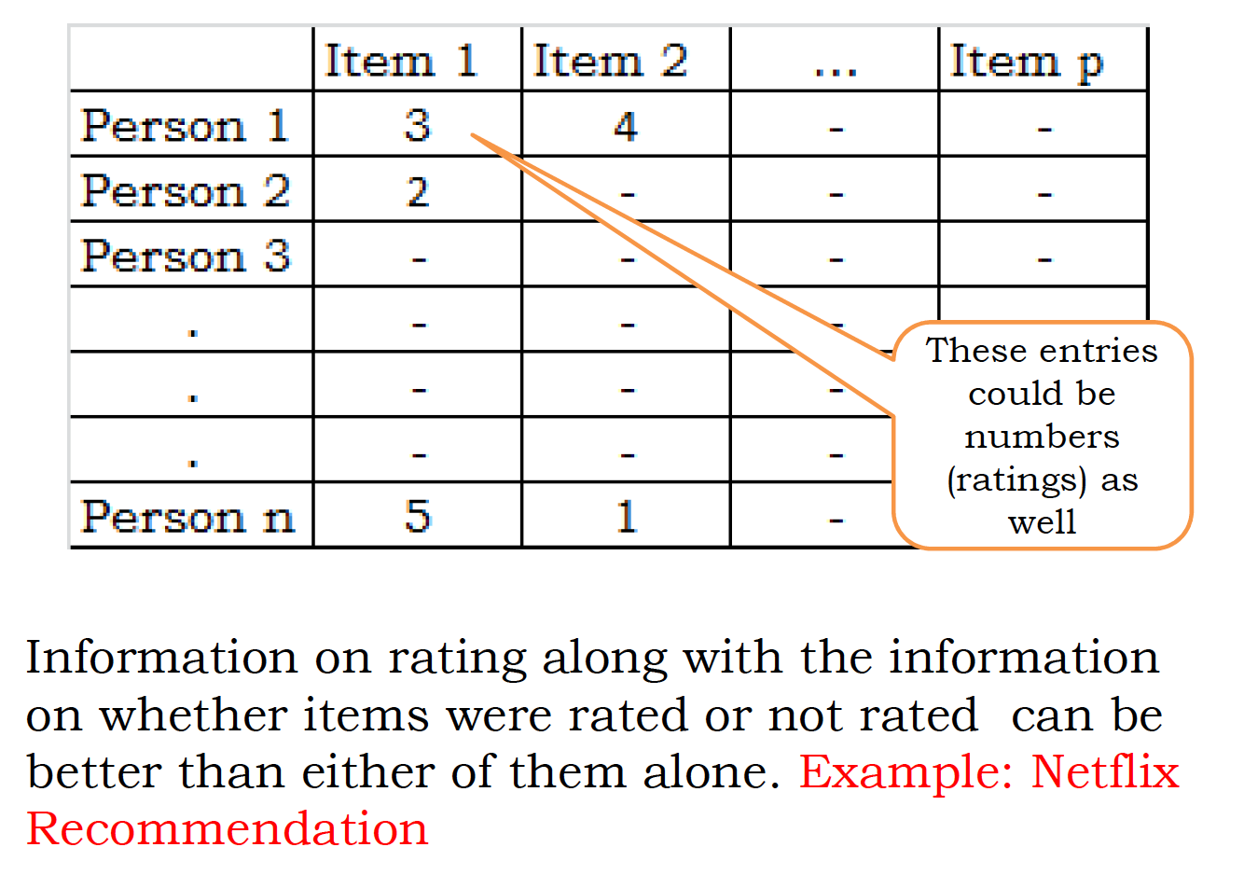

Slide 10
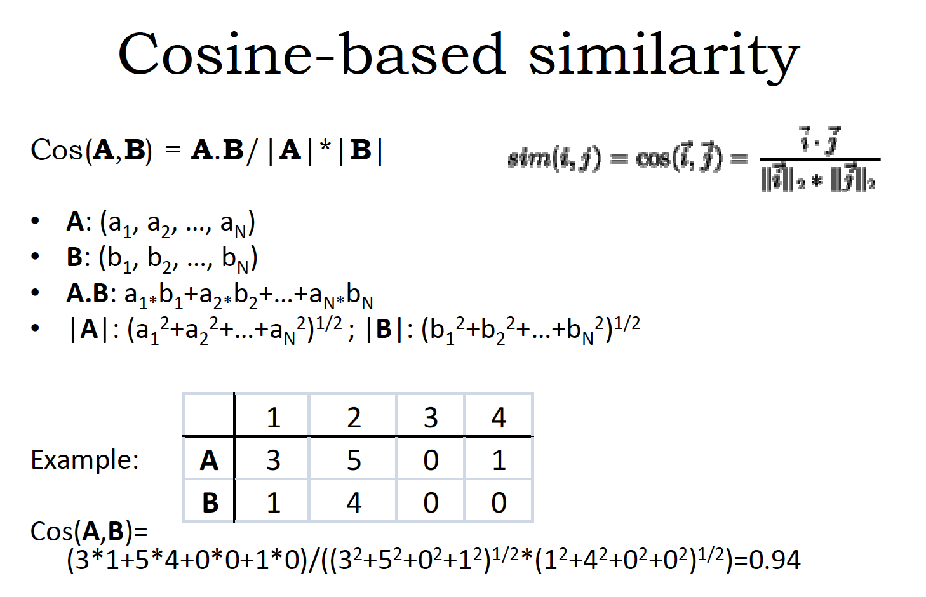

Slide 11
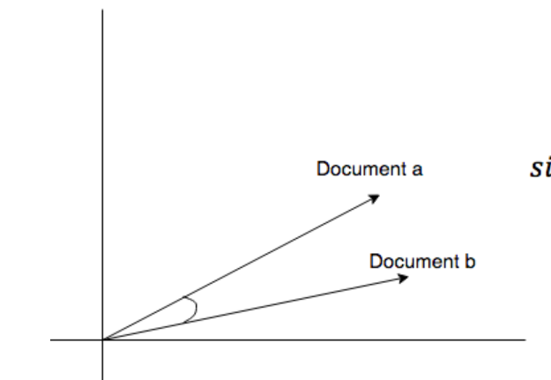
Cosine similarity
Measures the cosine of the angle between two vectors. It is a judgment of orientation rather than magnitude between two vectors with respect to the origin. The cosine of 0 degrees is 1 which means the data points are similar and cosine of 90 degrees is 0 which means data points are dissimilar.
Cosine similarity is subjective to the domain and application and is not an actual distance metric. For example data points [1,2] and [100,200], are shown as similar with cosine similarity, whereas the Euclidean distance measure shows them as being far away from each other (i.e., they are dissimilar).

Slide 12
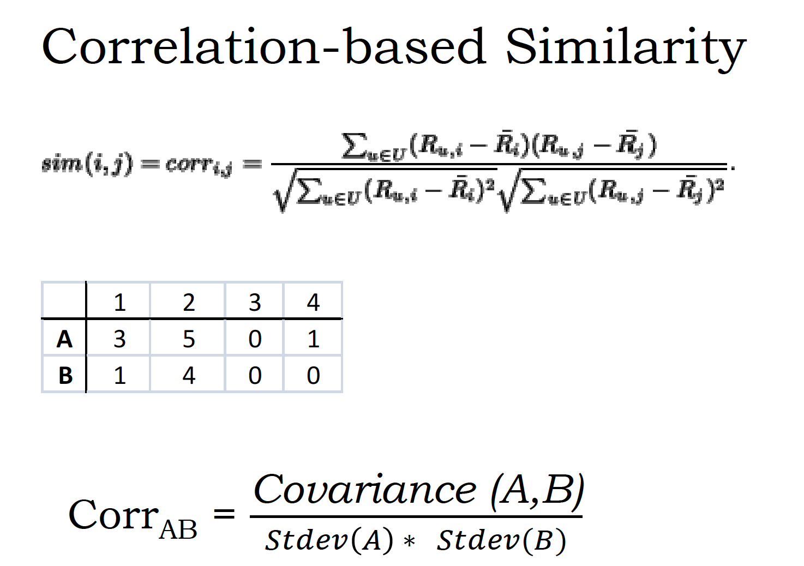
It is a measure of correlation between two random variables and ranges between [-1, 1].

Slide 13
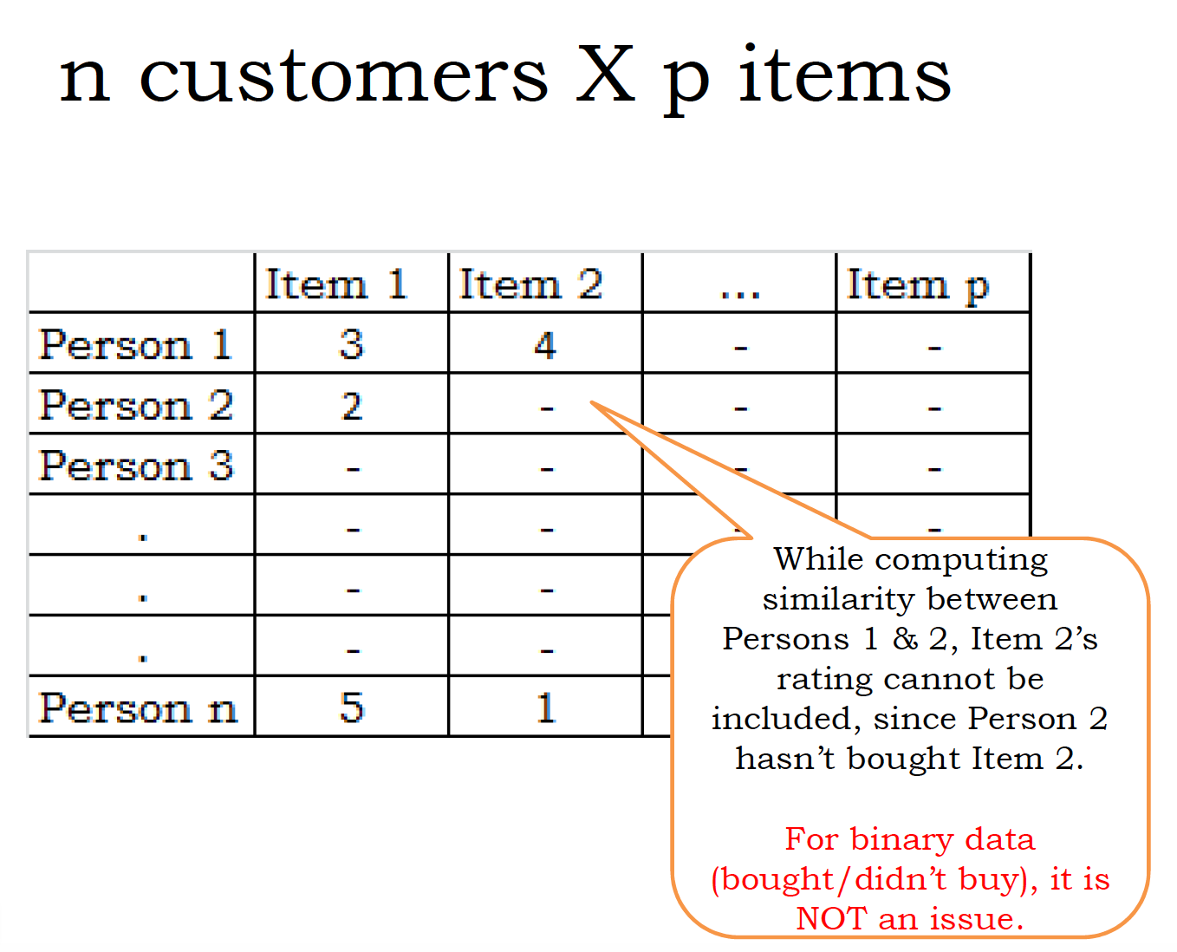

Slide 14
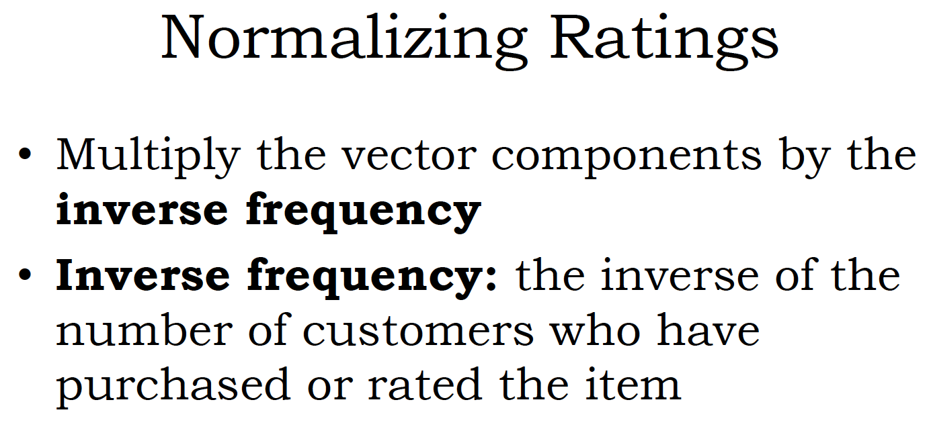

Slide 15
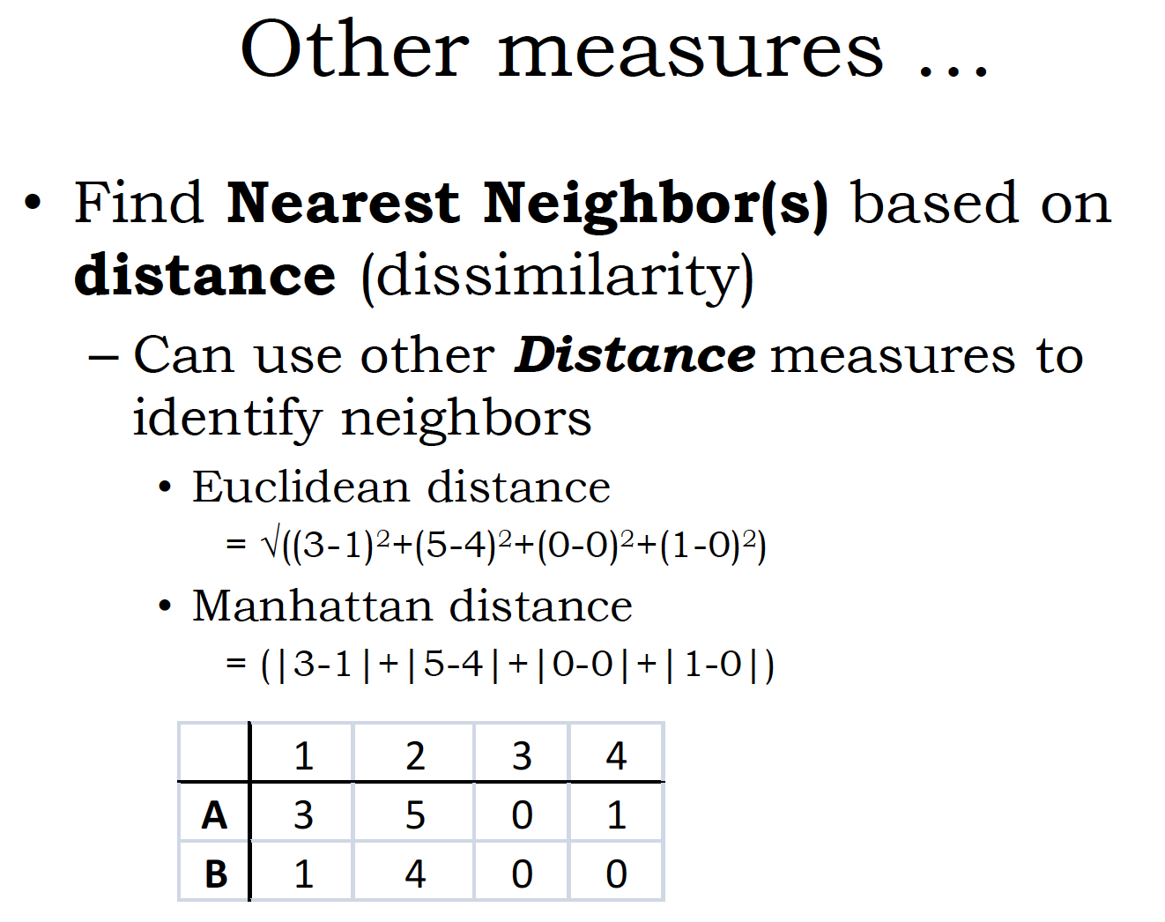

Slide 16
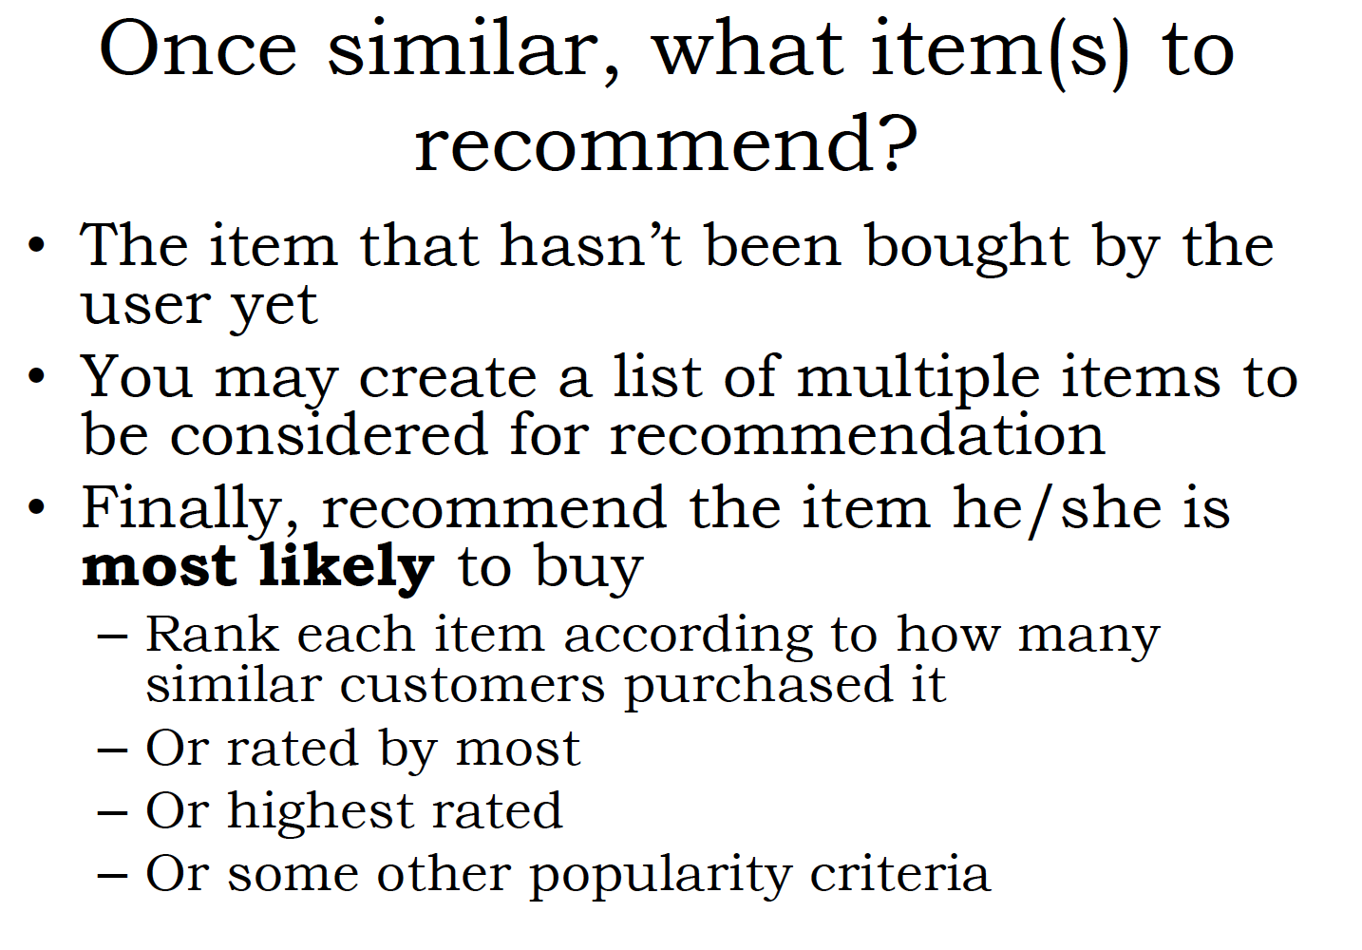
3

Slide 17
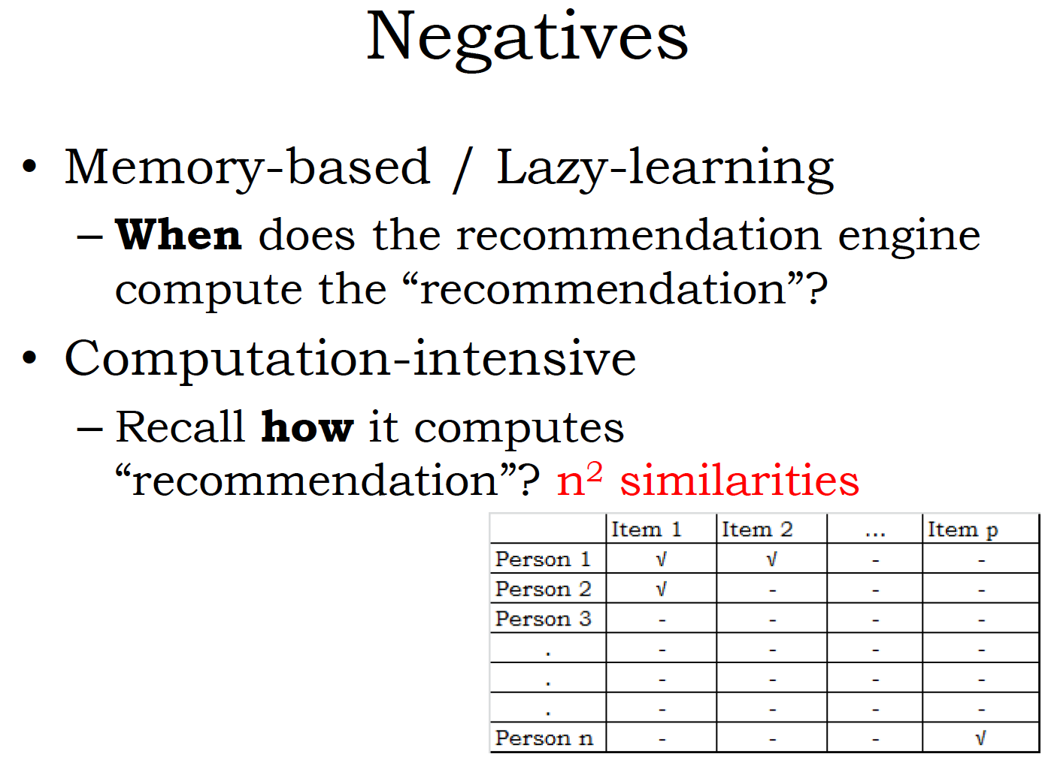

Slide 18
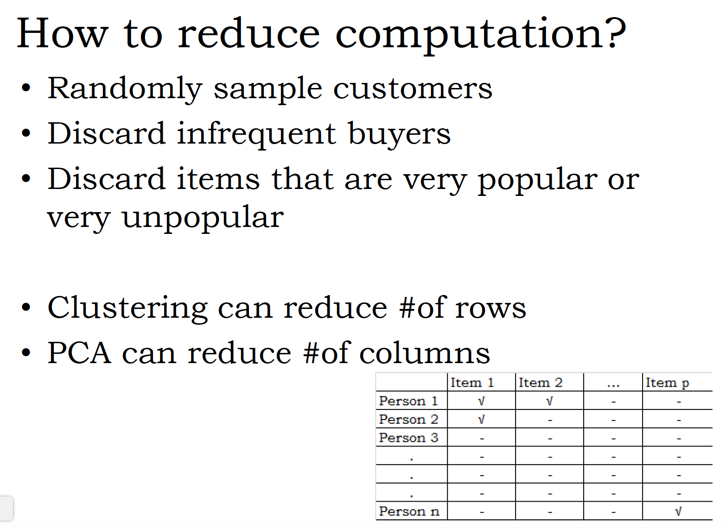

Slide 19
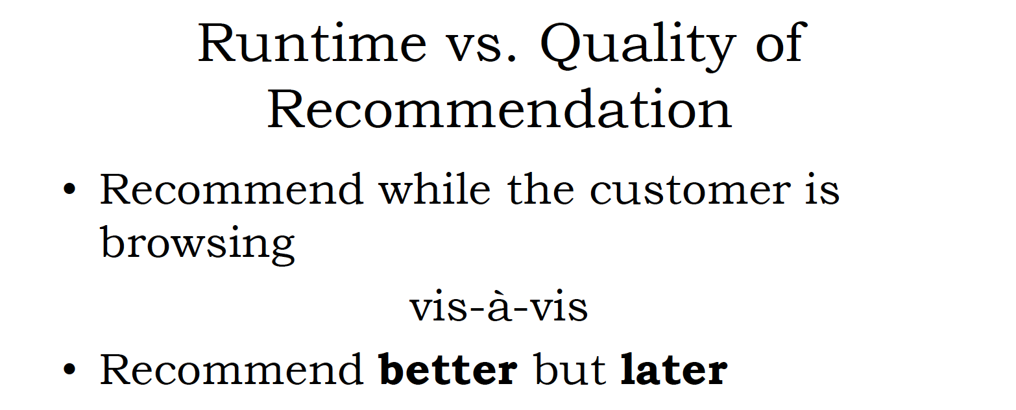

Slide 20
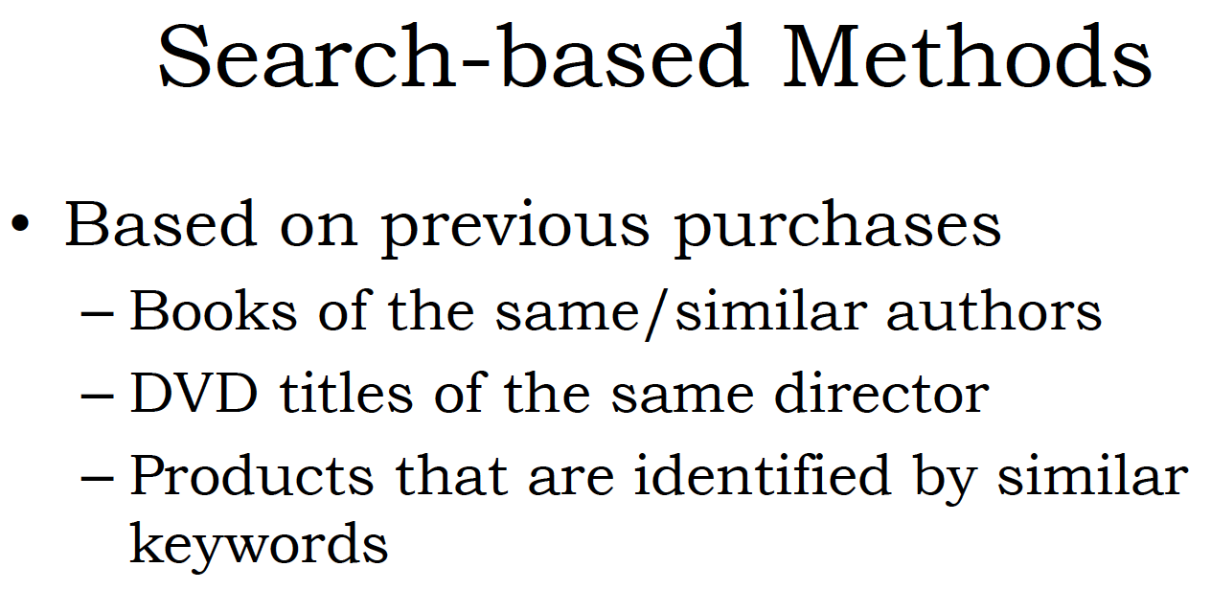

Slide 21
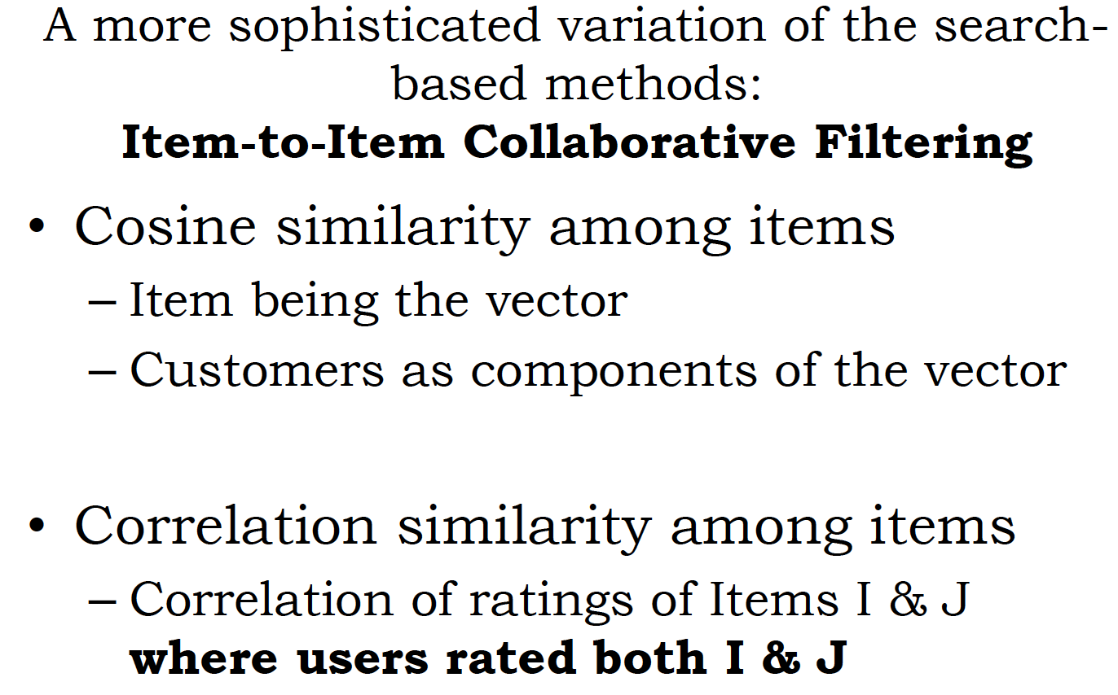

Slide 22
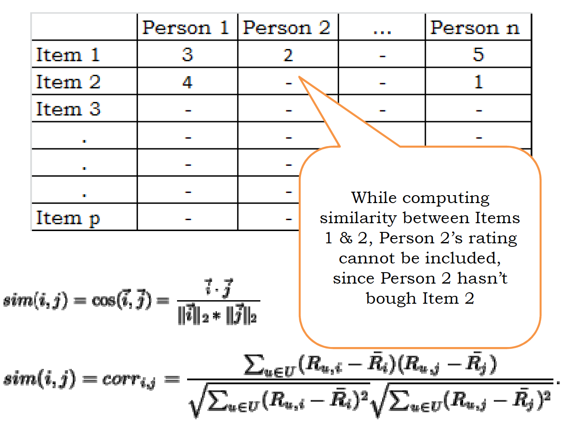

Slide 23
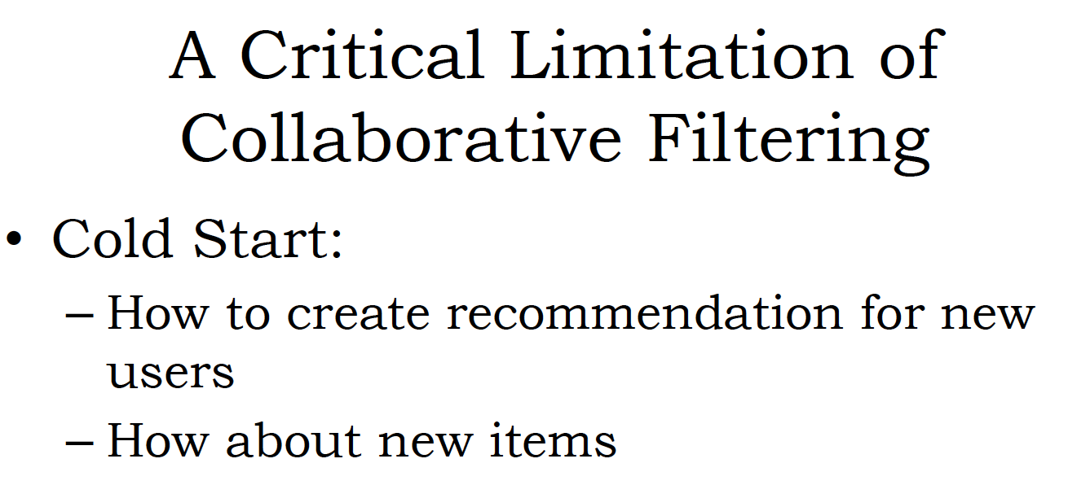

Slide 24
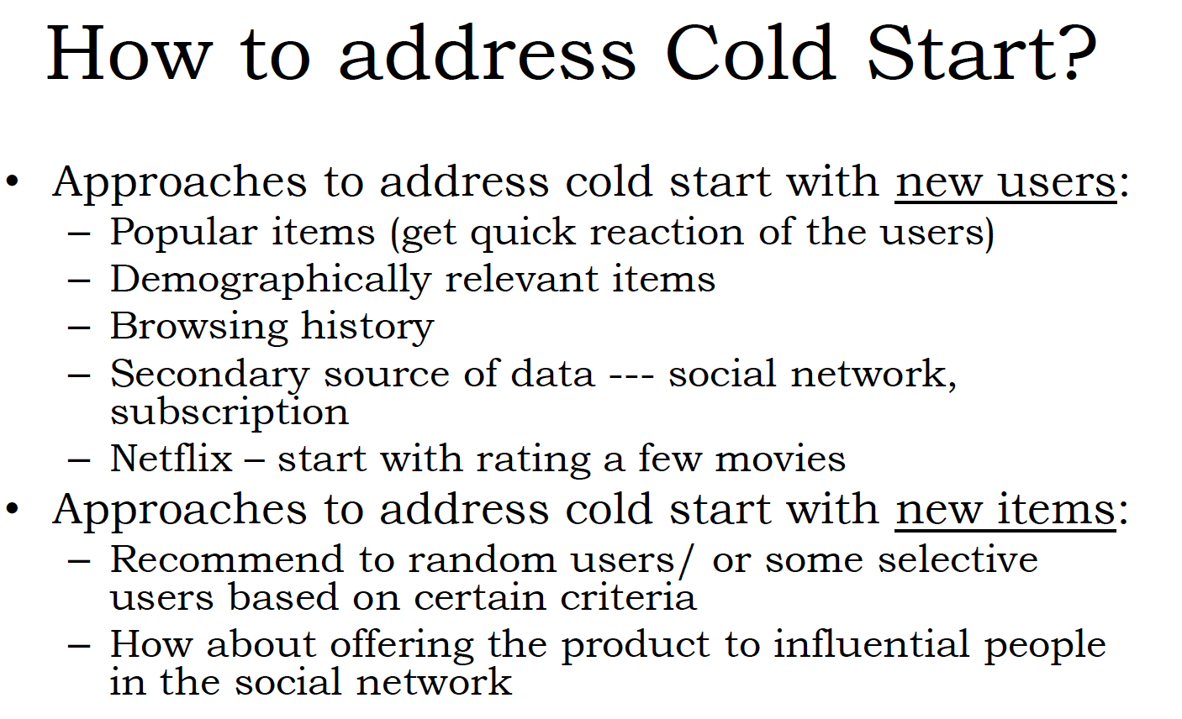

Slide 25
Thank you

